Slide 1
Employment Credits
Mike Welbes
Partner
October 15, 2013

Slide 2
Tools to Increase Your Bottom Line

Slide 3
Agenda
How can your company benefit from federal and state tax credits
What federal and state tax credits are available for your company
What are the requirements for various credits
What is the process for obtaining credits

Slide 4
Who benefits from hiring-related tax credits?
Employees
Communities
Employers

Slide 5
Federal tax credit programs
Congress has authorized billions in incentives to get employees back to work and to improve the economy.
Many of these incentives go unclaimed because businesses don’t know about the credits or do not have the tools or time to maximize these benefits.

Slide 6
Work Opportunity Tax Credit program
Provides businesses with an incentive to hire individuals from groups that have particularly high unemployment rates or special employment needs. Groups that are eligible:
Disabled or unemployed veterans
Ex-offenders
Vocational rehabilitation referrals
Summer youth employees
Food stamp recipients
Designated community resident
Recipients of Assistance Under Aid to Families with Dependent Children (AFDC) or its successor program, Temporary Assistance for Needy Families (TANF)
Supplemental Security Income (SSI) recipients
Short Term Temporary Assistance for Needy Families

Slide 7
Questions when considering WOTC
Are you taking advantage of tax credits for your business?
Do you have lower paying jobs?
Are you consistently hiring?

Slide 8
WOTC Calculation Breakout
Target Group | Maximum Qualified Wages | Maximum Credit Amount
Summer Youth Employee | $3,000 | 25% = $750 40% = $1200
Vocational Rehabilitation Referral Recipient of SNAP benefits (Food Stamps) SSI Recipient Qualified IV-A Recipient Qualified Veteran Qualified Ex-Felons Designated Community Resident (DCR) | $6,000 | 25% = $1500 40% = $2400
Long-Term Family Assistance Recipient | $10,000 (1st year) $10,000 (2nd year) | 25% = $2500 (1st year) 40% = $4000 (1st year) 50% = $5000 (2nd year)
Disabled Veteran | $12,000 | 25% = $3000 40% = $4800

Slide 9
WOTC Calculation Breakout VOW to Hire Heroes Act
Target Group | Maximum Qualified Wages | Maximum Credit Amount
Returning Heroes – unemployed 4 weeks or more | $6,000 | 25% = $1500 40% = $2400
Returning Heroes – unemployed 6 months or more | $14,000 | 25% = $3500 40% = $5600
Wounded Warrior – disabled veteran | $12,000 | 25% = $3000 40% = $4800
Wounded Warrior – disabled veteran unemployed for more than 6 months | $24,000 | 25% = $6000 40% = $9600

Slide 10
How to Calculate the WOTC
Credit calculates using
0 to 119 hours = 0% of qualified wages
120 to 399 hours = 25% of qualified wages
400 hours and up = 40% of qualified wages

Slide 11
WOTC Example Calculation $10/hour
Hours Worked | Wage | Credit Percentage | Credit
100 | $1000 | 0% | $0
300 | $3000 | 25% | $750
600 | $6000 | 40% | $2400

Slide 12
WOTC
How to estimate WOTC:
Number of employees
Percent of turnover
Example 500 employees with 100% turnover
500 x 15% = 75 x $1,000 = $75,000

Slide 13
WOTC Tax Benefits
Credit not a deduction
Credits can be carried back 1 year and can be carried forward 20 years
Credits offset Alternative Minimum Tax

Slide 14
WOTC Process
Every new hire completes the 2 forms:
8850 Form
9061 Form
All forms are mailed on a weekly basis; 28 day limit
All forms are tracked and reviewed to determine qualified employees
All qualified forms are submitted to their respective state to obtain an approved certificate

Slide 15
WOTC Process
Certificate comes back to HKP with confirmation of approval or denial
Information is logged
Quarterly billing – a request for wages and hours for each employee who qualifies will be sent out at the end of each quarter
Quarterly summary will be sent to client summarizing all their credits
HKP charges for credits earned

Slide 16
What’s New in WOTC
HKP has created proprietary software so that employees can submit forms online - this is a huge benefit to your clients because:
The process is now paperless, which saves time and money
Forms have mandatory fields which ensures accuracy
Employers are able to access real-time data:
Reports
Invoices
Employee forms
E-signature is also available through our software allowing the employee and employer to sign the forms electronically
For states offering e-filing, the process is all done electronically from start to finish

Slide 17
What’s New in WOTC (cont.)
Currently 23 states plus Washington, D.C. accept electronic submission of WOTC Forms
Reducing mail expenses, while maintaining your ability to claim these lucrative credits
Each state develops their own system for accepting electronic submission pending federal approval
Electronic filing will significantly speed up the approval process
Electronic signatures are valid on WOTC forms
Alabama
Arkansas
California
Colorado
Florida
Georgia
Idaho
Illinois
Indiana
Iowa
Kansas
Kentucky
Michigan
Minnesota
Nebraska
New Jersey
Ohio
Pennsylvania
South Carolina
Texas
Utah
Washington
West Virginia

Slide 18
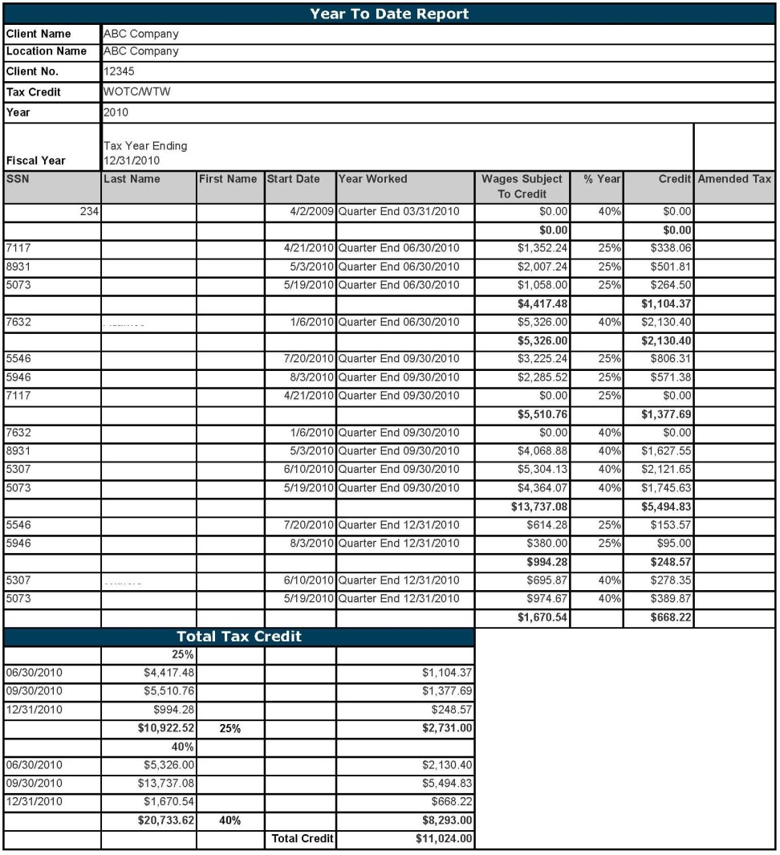
WOTC Reports
End of Year Report will provide the following:
Division/location
Employee information
Total wages and hours
Percent of credit
Total Credit

Slide 19
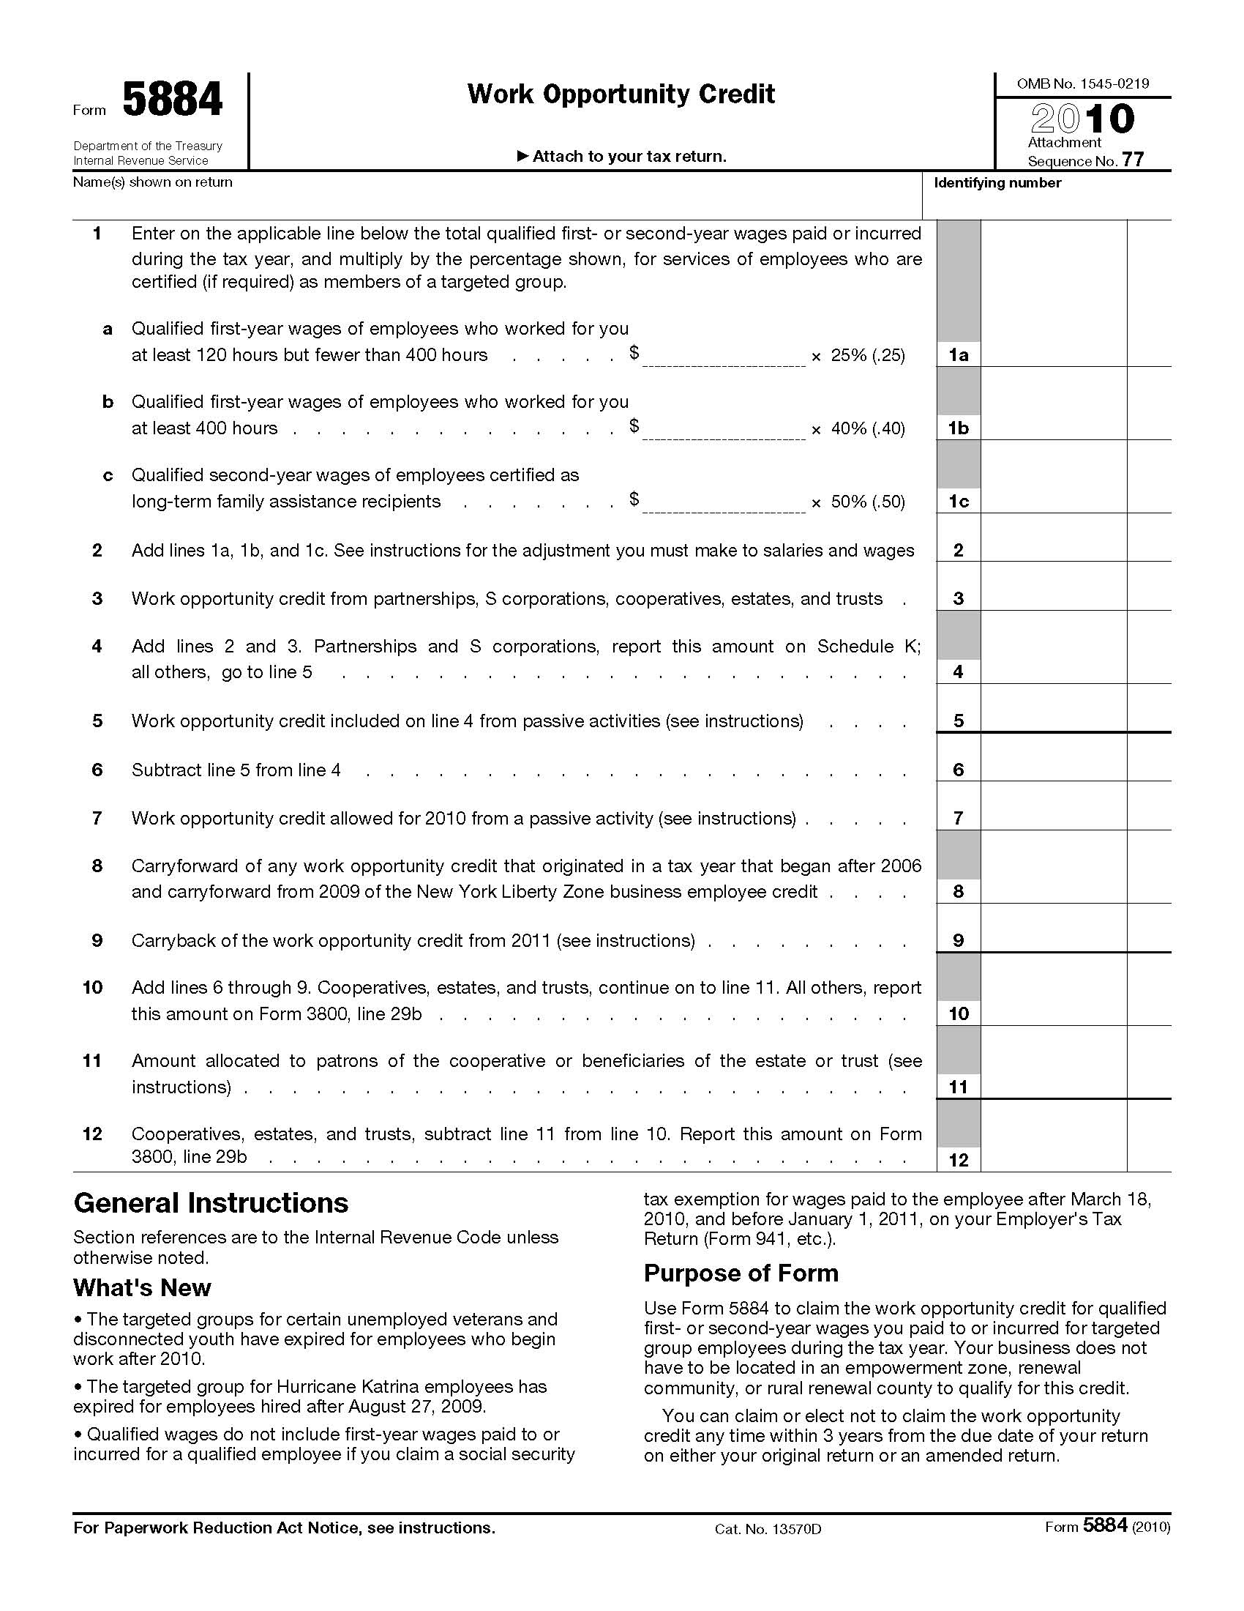
Claiming WOTC

Slide 20
Empowerment Zone Credits
To qualify, a business and employee need to be located within a designated federal zone
Client provides a list of all their locations with complete address information and then administrator can determine which locations are located within a zone
If client has any locations within a zone, an employee list with address information is provided by employer to confirm who lives within the zone
Empowerment Zone Credit is up to $3,000 per employee per year

Slide 21
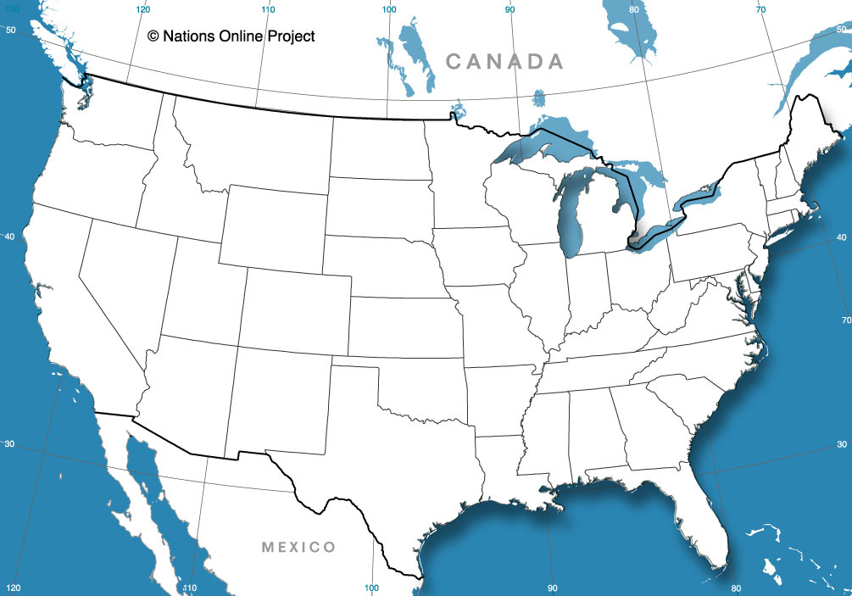
Urban Empowerment Zones
Pulaski County, AR
Tucson, AZ
Fresno, CA
Los Angeles, CA
Santa Ana, CA
New Haven, CT
Jacksonville, FL
Miami/Dade County, FL
Chicago, IL
Gary/Hammond/E Chicago, IN
Boston, MA
Baltimore, MD
Detroit, MI
Minneapolis, MN
St. Louis, MO/ East St. Louis, IL
Cumberland County, NJ
New York, NY
Syracuse, NY
Younkers, NY
Cincinnati, OH
Cleveland, OH
Columbus, OH
Oklahoma City, OK
Philadelphia, PA/Camden, NJ
Columbia/Sumter, SC
Knoxville, TN
El Paso, TX
San Antonio, TX
Norfolk/Portsmouth, VA
Huntington, WV/Ironton, OH

Slide 22
State Tax Credits
Many states have lucrative tax credits- some that even parallel the Federal Work Opportunity Tax Credit
Currently, nine states have credits for hiring veterans:
Alabama
Alaska
Connecticut
Delaware
Illinois
Frequently the credits are based on a business relocating, expanding or starting a business within a specific designated zone
With these credits, most often a business would need to apply for these programs in advance of the relocation, expansion or new business in order to qualify
New Mexico
New York
West Virginia
Wisconsin

Slide 23
HKP Workforce Management Solutions
Jarrod Haiar, Workforce Management Consultant
Over eight years of workforce management experience
Works with businesses and franchise organizations on cost-effective and timely workforce management solutions.

Slide 24
HKP One Company, One Roof
Seamless integration with HKP payroll eliminating additional wage & hour reporting requirements
Simplified process for tax credits and payroll through one company, HKP
Affiliate of a Top 100 CPA firm in the U.S.
Dedicated staff

Slide 25
Web-based SaaS
One database: Payroll, HRMS, Benefits, T&A
Report builder
Employee self-service
Manager self-service
Integration with accounting systems & third party administrators
Applicant tracking interfaces

Slide 26
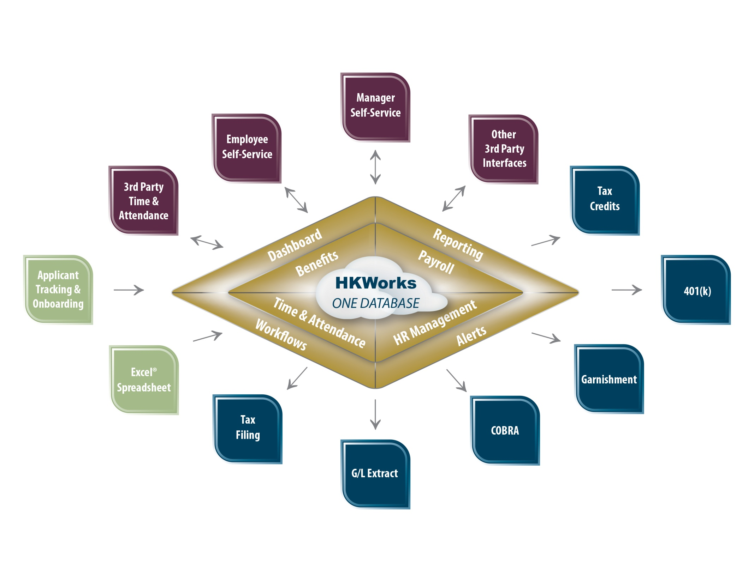

Slide 27
Review
WOTC program is simple to administer when you are working with a quality provider.
Take advantage of lucrative tax credits to improve your bottom line.
Integrate your payroll and tax credit solutions to simplify the process.

Slide 28
Questions
Mike Welbes
Partner
mwelbes@honkamp.com
Jarrod Haiar
Business Development Representative
jhaiar@honkamp.com
888.556.0123

